Slide 1

NI
Lecture
Networking Infrastructure
Ethernet Switching - Spanning Tree Protocol
& Ethernet Evolution
2
Networking Infrastructure
Diploma in CSF / IT
Year 2 (2020/2021), Semester 3
Notes:
Left-hand Bar – Replace FSP by your module code and X by the lecture number.
Replace Lecture Title
Replace < Module Name >
Replace Year and Semester if necessary

Slide 2
Objectives :
Layer 2 switching operations
Switching modes
Redundancy in switch topologies
Spanning Tree Protocol
Evolution of Ethernet Technologies: Fast & Gigabit Ethernet (optional)

Slide 3
Layer 2 Switching Operations
Address Learning (Recap)
Flooding (Recap)
Forward (Recap)
Filter Decision
Aging

Slide 4
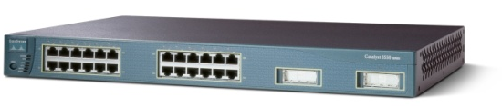
Layer 2 Switching – Address Learning
D
A
C
E
2
1
Data from A to B
3
Switch
4
MAC Address Table
B
Interfaces/Ports
1 2 3 4
A
Learns the source MAC address of each
data frame that is transmitted and noting the port where the frame enters the switch
Stations

Slide 5
Layer 2 Switching – Flooding
D
A
C
Data from A to B
E
Switch
2
3
1
Data from A to B
B
4
MAC Address Table
Interfaces/Ports
1 2 3 4
Sends out on all ports (except the port that the frame entered from) when the destination MAC address is unknown (not in Table) or a broadcast (no need to refer to Table)
A
Data from A to B
Stations

Slide 6
Layer 2 Switching – Forwarding
D
A
C
E
2
1
Data from B to A
3
Switch
4
Forwards when the
destination MAC matches an entry in the Table
MAC Address Table
B
Interfaces/Ports
Data from B to A
1 2 3 4
A
B
Stations
Learns the source MAC address of each
data frame that is transmitted and noting the port where the frame enters the switch

Slide 7
Layer 2 Switching – Filtering
D
A
C
E
2
1
3
Data from A to C
Switch
4
Filters when the destination
is located on the same port (both A & C are under port 3 in the Table)
MAC Address Table
B
Interfaces/Ports
1 2 3 4
E
D
A
B
Stations
C

Slide 8
Layer 2 Switching Operations
If the destination address is unknown to the switch, it forwards the frame to all segments except the one on which it was received
this process is known as flooding
If the destination device is on a different segment, the switch forwards the frame to the appropriate segment
this process is known as forwarding
If the destination device is on the same segment as the frame, the switch blocks the frame from going on to other segments
this process is known as filtering
Notes:
An ethernet switch is a multiport ethernet bridge. A bridge is a device that splits collision domains but not broadcast domains.
A switch is simply a bridge with lots of ports.
Note: some wireless router may be configured as a bridge (without routing).

Slide 9
Layer 2 Switching Operations
How a Switch populates MAC address table and performs Aging of entries
Learns the MAC address of each device on the network
reads the source MAC address of each data frame that is transmitted and noting the port where the frame entered the switch
Addresses are learnt dynamically and added to the MAC Address Table (or switching table)
address is time stamped
address is stored for a set period of time – Age Time (default 300 sec)
addresses that are not referenced beyond the Age Time are removed - Aging
maintains an accurate and functional table by removing aged addresses

Slide 10
Switching Modes
Switching Modes
How the contents of a frame is switched to the destination port?
Three switching modes {offering different performance & latency } :
Store-and-Forward Switching
Cut-Through Switching
Fragment-Free Switching

Slide 11

Switching Modes
Checked the frame. It is good (FCS). I am to forward the frame now.
FCS
Data
Type
SA
DA
Source
Switch
Destination
Store-and-Forward Switching

Slide 12
Store-and-Forward Switching
Read the entire frame into memory buffer & determine whether the frame is valid or invalid.
Fragment less than 64 bytes due to collision.
Corrupted frame detected using the FCS field.
Advantage: prevents wasting the bandwidth on the destination network by invalid or bad frames that can adversely affect the network performance.
Downside: the frame error checking and memory buffering contributes to greater delay or latency.

Slide 13
Switching Modes
I have the destination MAC address (DA). I can transmit the frame now.
FCS
Data
Type
SA
DA
Source
Switch
Destination
Cut-Through Switching

Slide 14
Cut-Through Switching
sometimes referred to as fast forward switching or on-the-fly switching.
Reads the beginning of the frame up to the destination MAC address field in the data frame as the traffic flows through the switch.
Does not wait for the entire data frame to be read in before switching the frame to the destination port i.e. “cut-through” .
Advantage: fast and minimum latency; requires less buffer memory
Downside: lacks frame error checking; forwards corrupted frame and fragments and could congest the network traffic with unwanted invalid frames (when traffic levels increase, as more errors are more likely to occur)

Slide 15
Switching Modes
I have received the 1st 64 bytes (min Eth frame size). I can transmit now.
1st 64 bytes
FCS
Data
Type
SA
DA
Source
Switch
Destination
Fragment-Free Switching

Slide 16
Fragment-Free Switching
Frames are buffered until the first 64 bytes have been received
Can check for any bad frames (fragments less than 64 bytes due to collisions) but will not be able to detect frames with FCS errors.
Results in lesser latency (compared to store-and-forward) as the frame is sent after it has read 64 bytes.

Slide 17
Switching Modes Summary
Modes
Advantages
Disadvantages
Store-and-Forward
“Latency” to read
whole frame - varies
No bad frames
Very fast =>
Low constant latency
Forward fragments &
error frames
Cut-through
Fragment-Free
Filters out fragments
Forward error frames

Slide 18
Switching Modes Summary
Store-and-forward switching mode
Reads and check whole frame before forwarding
Advantage: No invalid frames forwarded
Disadvantage: Variable latency (delay in switch)
Cut-Through switching mode
Reads and check destination address only before forwarding
Advantage: Low constant latency
Disadvantage: Fragments and error frames forwarded
Fragment-Free switching mode
Reads and checks first 64 bytes of frame only before forwarding
Advantage: No frames less than 64 bytes long are forwarded
Disadvantage: Error frames forwarded

Slide 19
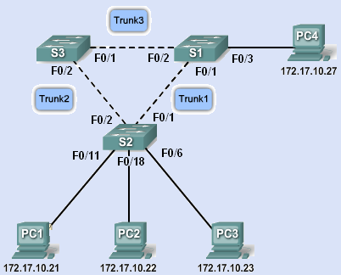
We want achieve:
Resilience (using redundancy) with multiple switches and trunk links
One link or device fails – another takes over.

Slide 20
Problems with redundancy
Switching loops give problems if all the links are active:
Broadcast storms
Multiple frame transmission
Inconsistent switch tables

Slide 21
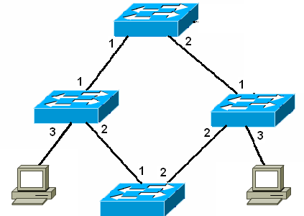
Broadcast Storm
Flood broadcast through non-source ports
And so on with nothing to stop it
There’s a switching loop
Send ARP request

Slide 22
Multiple Frame Transmissions
A is on port 3
Don’t know B
So flood
Send frame to B
Frame arrives
A
B
And again

Slide 23
Inconsistent switch tables
?
A is on port 3
Don’t know B
So flood
A is on port 1
A is on port 2
???
A is on port 3
A is on port 1
A is on port 2
Send frame to B
A
B

Slide 24
Redundancy without loops
There needs to be just one path at a time.
Redundant paths must be shut down, but ready to be opened when they are needed.
This must be done quickly and automatically.
Spanning Tree Protocol does this.

Slide 25
What is a spanning tree?
A tree (extended star) topology
A tree has no loops
Spanning all devices
All devices are connected

Slide 26
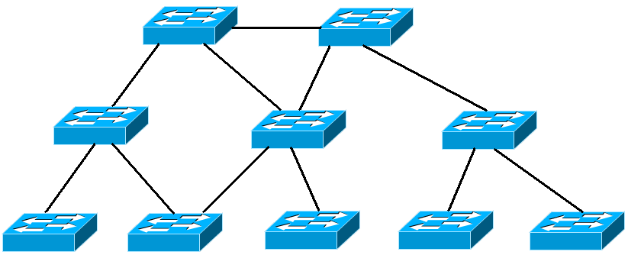
Not a spanning tree
There are loops.

Slide 27
Not a spanning tree
Device left out.

Slide 28
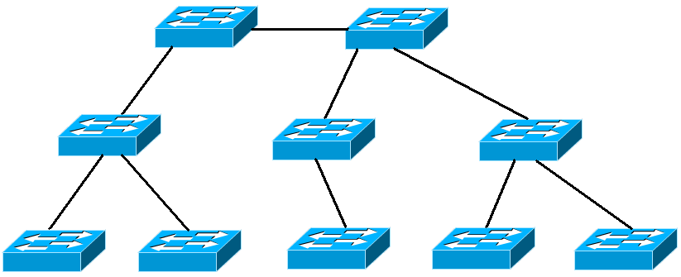
Spanning tree
No loops. Includes all devices.

Slide 29
Spanning tree protocol
Used by switches to turn a redundant topology into a spanning tree
Disables unwanted links by blocking ports
STP defined by IEEE 802.1d
Rapid STP defined by IEEE 802.1w
Switches run STP by default – no configuration needed.

Slide 30
Spanning tree algorithm
The switches use this algorithm to decide which ports should be shut down.
Select one switch to be “root bridge”
Select a “root port” on each other switch
Select a “designated port” on each segment.
Close down all other redundant ports/links.

Slide 31
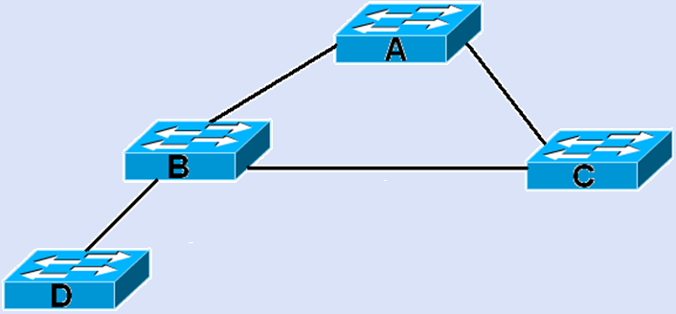
Outline of process
Root bridge
Designated port
Designated port
Root port
Root port
Root port
Designated port
Designated port
Not chosen Block/Close down

Slide 32
1 Select the root bridge
Each switch has a bridge ID (BID) of priority value followed by MAC address
Switches exchange Bridge Protocol Data Units (BPDUs) to compare bridge IDs
The switch with the lowest bridge ID becomes the root bridge
Administrator can set the priority to fix the selection

Slide 33
1 Select the root bridge
The bridge ID consists of bridge priority, extended system ID, and MAC address
By default the priority is 32768
Lowest priority wins
Value 1 - 65536, multiples of 4096
Extended system ID identifies VLAN.
MAC address used if priority is the same. Better not to rely on MAC address.

Slide 34
1 Select the root bridge
A switch starts up. It sends out BPDU frames containing the switch Bridge ID (BID) and the root ID every 2 seconds.
At first each switch identifies itself as the root bridge.
If a switch receives a BPDU with a lower BID then it identifies the switch with that BID as root bridge. It passes on this information in its own BPDUs.
Eventually all switches agree that the switch with the lowest BID is the root bridge.

Slide 35
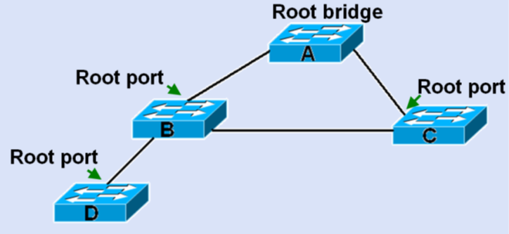
2. Select root ports
Every non-root bridge/Switch selects a root port
This is the port with the shortest distance / lowest cost path to the root bridge/switch
If same distance, use the one with lowest ID

Slide 36
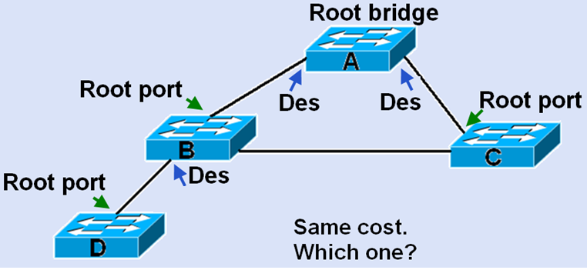
3. Select designated ports
On every segment, the port with the lowest cost path to the root bridge becomes the designated port

Slide 37
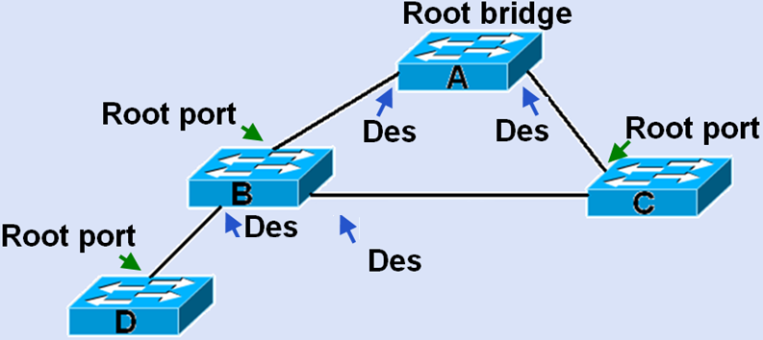
Designated port if same distance/cost
Choose the port on the switch with the lower bridge ID. Suppose this is switch B.

Slide 38
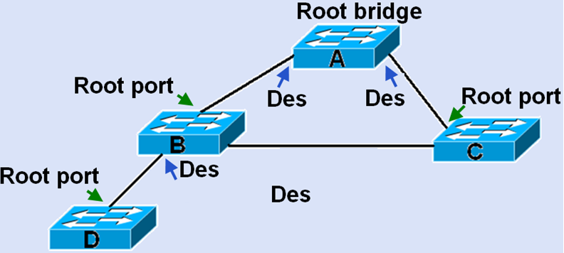
4. Close down all redundant links/ports
Any port that is not a root port or a designated port is put in blocking state

Slide 39
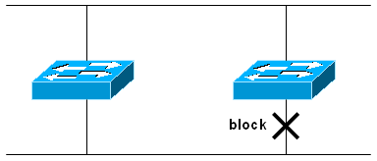
Spanning Tree Overview
Spanning Tree Protocol (STP) is a Layer 2 link-management protocol that provides path redundancy while preventing undesirable loops
A loop-free topology is accomplished when the switch recognizes a loop in the topology and logically blocks one or more redundant ports automatically
Bridge Protocol Data Units (BPDUs) are used by switches in a network to exchange information regarding their status
The switches use the Spanning Tree Algorithm (STA) to resolve and shutdown redundant paths
STP is defined in the IEEE 802.1d specification

Slide 40
Spanning Tree Protocol Summary
Redundant Paths is good for network resilience
Broadcast Storms caused by redundant paths
Spanning Tree Protocol (STP) overcomes broadcast storms by using Loop Avoidance
Redundant paths are blocked (made inactive)
Only one active path between any node (e.g. PC) in the network
Should active path fail, blocked path is activated automatically
Hence network resilience is achieved without broadcast storms

Slide 41
Evolution of Ethernet (Optional)
First proposed in 1973
First tested in 1976: 3 Mbps
First standardized in 1980: 10 Mbps
Wireless (802.11b) in 2000: 11 Mbps
Currently being developed: 100Gbps
Bit rates and signal encoding (Layer 1) differ among the main versions
The frame structure (Layer 2) remains more or less the same
CSMA/CD & Half Duplex (Layer 2) not supported from 10Gigabit Ethernet upwards

Slide 42
Types of Ethernet
Logical link Control Sublayer
802.3 Media Access Control (MAC)
Physical
Signalling
Sublayer
10BASE5 (500m)
50 Ohm Coax N-Style
10GBase-(Various)
MM or SM Fiber SC
10BASE2 (185m)
50 Ohm Coax BNC
10BASE-T (100m)
100 Ohm UTP RJ45
100BASE-TX (100m)
100 Ohm UTP RJ45
100BASE-FX (228-412m)
MM Fiber SC
1000BASE-T (100m)
100 Ohm UTP RJ45
1000Base-SX (220-550m)
MM Fiber SC
1000Base-LX (550-5000m)
MM Fiber SC
Physical
Medium

Slide 43

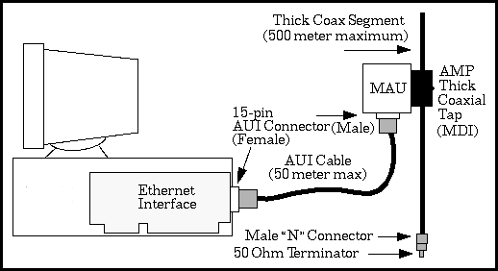
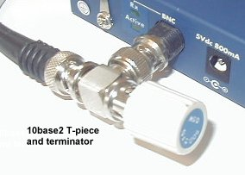
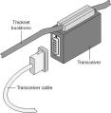
Legacy Ethernet – 10Mbps
Type
Standard
Cabling Type
Distance
10BASE5
Thicknet
“Original”
1980
50 Ohm Thick Coaxial N Style
500m
10BASE2
Thinnet
802.3a-
1985
50 Ohm Thin Coaxial BNC
185m
10BASE-T
802.3i-
1990
100 Ohm UTP RJ45
100m

Slide 44
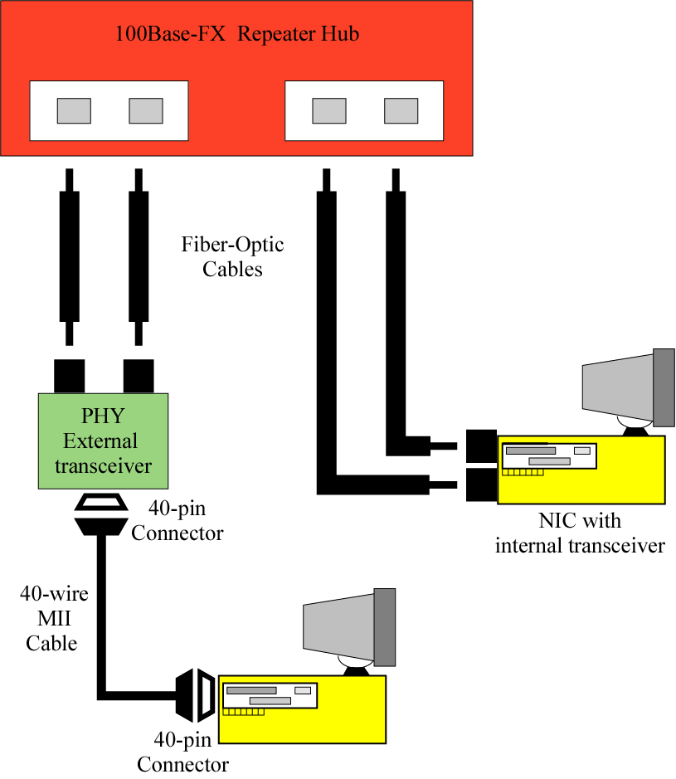
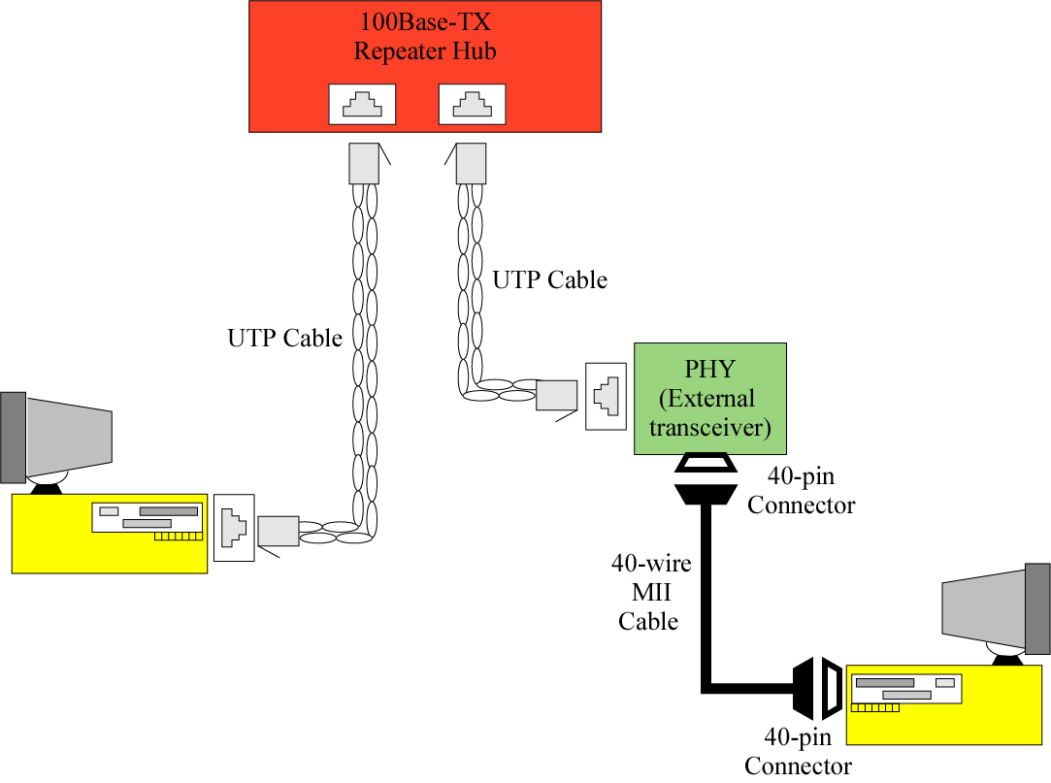
Fast Ethernet – 100Mbps
Type
Standard
Cabling Type
Distance
100BASE-TX
802.3u-
1995
100 Ohm UTP RJ45
Two pairs of twisted-pair
100m
100BASE-FX
802.3u-
1995
Multimode Fiber Optic
412m
100Base-TX
Implementation
100Base-FX
Implementation

Slide 45
Gigabit Ethernet – 1000Mbps or 1Gbps
Type
Standard
Cabling Type
Distance
Medium Modal Bandwidth
62.5um MMF 160 MHz/km 220m
802.3z-
1998
1000BASE-SX
62.5um MMF 200 MHz/km 275m
50um MMF 400 MHz/km 500m
50um MMF 500 MHz/km 550m
62.5um MMF 500 MHz/km 550m
802.3z-
1998
1000BASE-LX
50um MMF 400 MHz/km 550m
50um MMF 500 MHz/km 550m
10um SMF - 5000m
1000BASE-T
802.3ab-
1999
100 Ohm UTP RJ45
100m

Slide 46
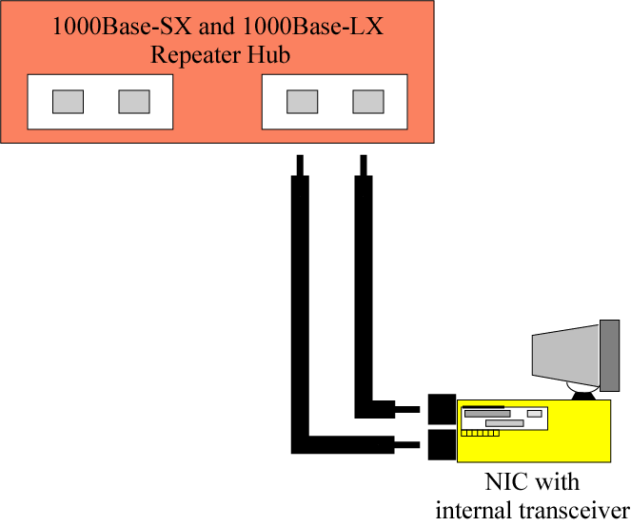
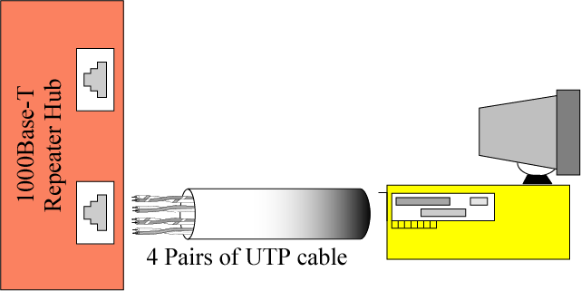
Gigabit Ethernet – 1000Mbps or 1Gbps
1000Base-T Implementation
Uses at least Cat 5 UTP
Four twisted pairs
1000Base-X Implementation
Two fiber-optic cables
Short wavelength (SX)
Long wavelength (LX)
Notes:
Cat 5 and 5e UTP cables are no longer available in the market

Slide 47
10 Gigabit Ethernet
10GBASE-SR
2002
Short distances over 62.5µm MMF,
range from 26 – 82m. Over 50 µm, range 300m
10GBASE-LX4
2002
300m over 62.5µm MMF, 10km over SMF
10GBASE-LR
10GBASE-ER
2002
LR supports 10km,
ER supports 40km over SMF
10GBASE-SW
10GBASE-LW
10GBASE-EW
2006
Intended to work with OC-192STM SONET/ SDH
WAN equipment
10GBASE-T
2006
100m, at least Cat 6a UTP

Slide 48
Ethernet Trends
1Gbps is widely used
10Gbps used for server and backbone connections
40Gbps currently available
100Gbps is emerging
160Gbps wired and 640 Mbps wireless in future(?)
Networking Media likely to remain
Copper
Optical fiber
Wireless
Research on 40 Gbps and 100 Gbps

Slide 49
Summary
Spanning Tree Protocol
Root bridge/switch
Root port
Designated port
Block port
Evolution of Ethernet (Optional)
Pre-standard Ethernet (1976)
Ethernet (1980)
Fast Ethernet (1995)
Gigabit Ethernet (1998)
10 Gigabit Ethernet (2002)
40 Gbps and 100 Gbps Ethernet (2007)
160 Gbps wired & 640 Mbps wireless?

